Slide 1
BANK CUSTOMER CHURN
Oscar González

Slide 2

What is the goal?
To predict which customers will churn

Slide 3
eda

Slide 4
The Dataset
CustomerId | Surname | CreditScore | Geography
Gender | Age | Tenure | Balance
NumOfProducts | HasCrCard | IsActiveMember | EstimatedSalary
Exited | Complain | Satisfaction Score | Card Type Points Earned

Slide 5
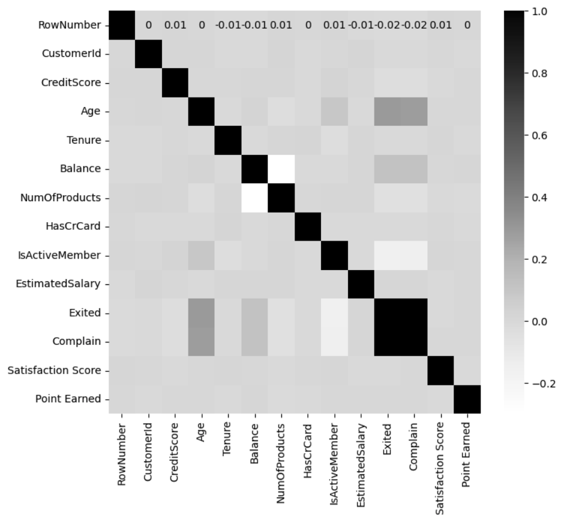
Correlation between variables

Slide 6
Correlation between variables
100% correlation between ‘Exited and Complain’

Slide 7
Correlation between variables
100% correlation between ‘Exited and Complain’
Notable correlation between ‘Age’ & ‘Exited’

Slide 8
Correlation between variables
100% correlation between ‘Exited and Complain’
Notable correlation between ‘Age’ & ‘Exited’
No correlation between ‘Balance’ & Number of Products’
Notes:
Comments:
- Age & Exited: Notable correlation, older customers might be more likely to exit
- Balance & number of products: moderate correlation, customers with a higher balance tend to have more products
- Exited & complain: Significant correlation, customers who complain are more likely to exit.
How can we avoid the customer churn (exited)?

Slide 9
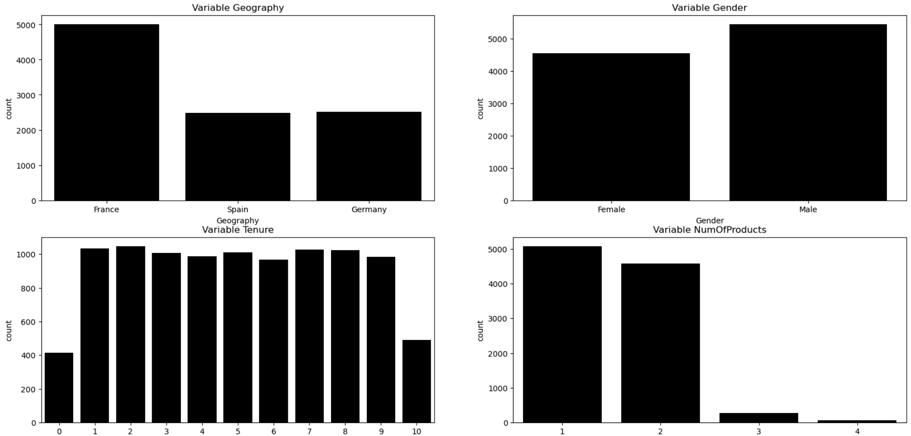
Univariate Analysis
Notes:
Geography: Customers mostly from France.
Gender: Normal distribution, sightly more males than females.
Tenure: Balanced distribution, with a drop in the 10th year.
Number of Products: Most of the customers have 1 or 2 products, only few have more.

Slide 10
Univariate Analysis
Notes:
Geography: Customers mostly from France.
Gender: Normal distribution, sightly more males than females.
Tenure: Balanced distribution, with a drop in the 10th year.
Number of Products: Most of the customers have 1 or 2 products, only few have more.

Slide 11
Univariate Analysis
Notes:
Geography: Customers mostly from France.
Gender: Normal distribution, sightly more males than females.
Tenure: Balanced distribution, with a drop in the 10th year.
Number of Products: Most of the customers have 1 or 2 products, only few have more.

Slide 12
Univariate Analysis
Notes:
Geography: Customers mostly from France.
Gender: Normal distribution, sightly more males than females.
Tenure: Balanced distribution, with a drop in the 10th year.
Number of Products: Most of the customers have 1 or 2 products, only few have more.

Slide 13
Univariate Analysis
Notes:
Geography: Customers mostly from France.
Gender: Normal distribution, sightly more males than females.
Tenure: Balanced distribution, with a drop in the 10th year.
Number of Products: Most of the customers have 1 or 2 products, only few have more.

Slide 14
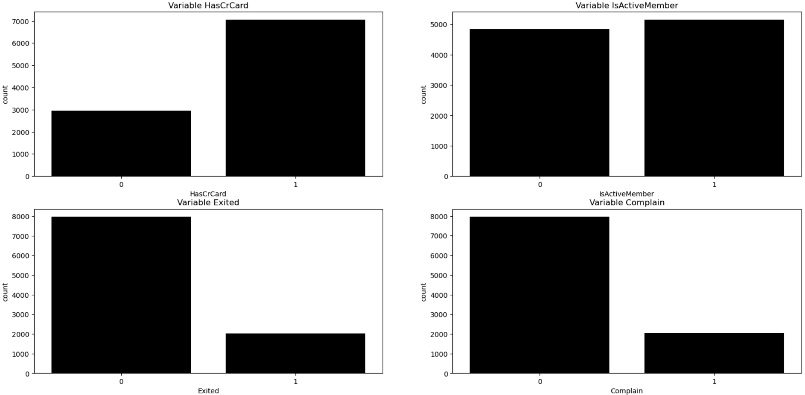
Univariate Analysis
Notes:
Has Credit Card: Most of the customers have a creadit card.
Is Active Member: Almost half of the customers are not active.
Exited: Aprox 20% of customers exited.
Complain: Aprox 20% of customers exited, direct correlation with exited as showed before in the correlaion map.

Slide 15
Univariate Analysis
Notes:
Has Credit Card: Most of the customers have a creadit card.
Is Active Member: Almost half of the customers are not active.
Exited: Aprox 20% of customers exited.
Complain: Aprox 20% of customers exited, direct correlation with exited as showed before in the correlaion map.

Slide 16
Univariate Analysis
Notes:
Has Credit Card: Most of the customers have a creadit card.
Is Active Member: Almost half of the customers are not active.
Exited: Aprox 20% of customers exited.
Complain: Aprox 20% of customers exited, direct correlation with exited as showed before in the correlaion map.

Slide 17
Univariate Analysis
Notes:
Has Credit Card: Most of the customers have a creadit card.
Is Active Member: Almost half of the customers are not active.
Exited: Aprox 20% of customers exited.
Complain: Aprox 20% of customers exited, direct correlation with exited as showed before in the correlaion map.

Slide 18
Univariate Analysis
Notes:
Has Credit Card: Most of the customers have a creadit card.
Is Active Member: Almost half of the customers are not active.
Exited: Aprox 20% of customers exited.
Complain: Aprox 20% of customers exited, direct correlation with exited as showed before in the correlaion map.

Slide 19
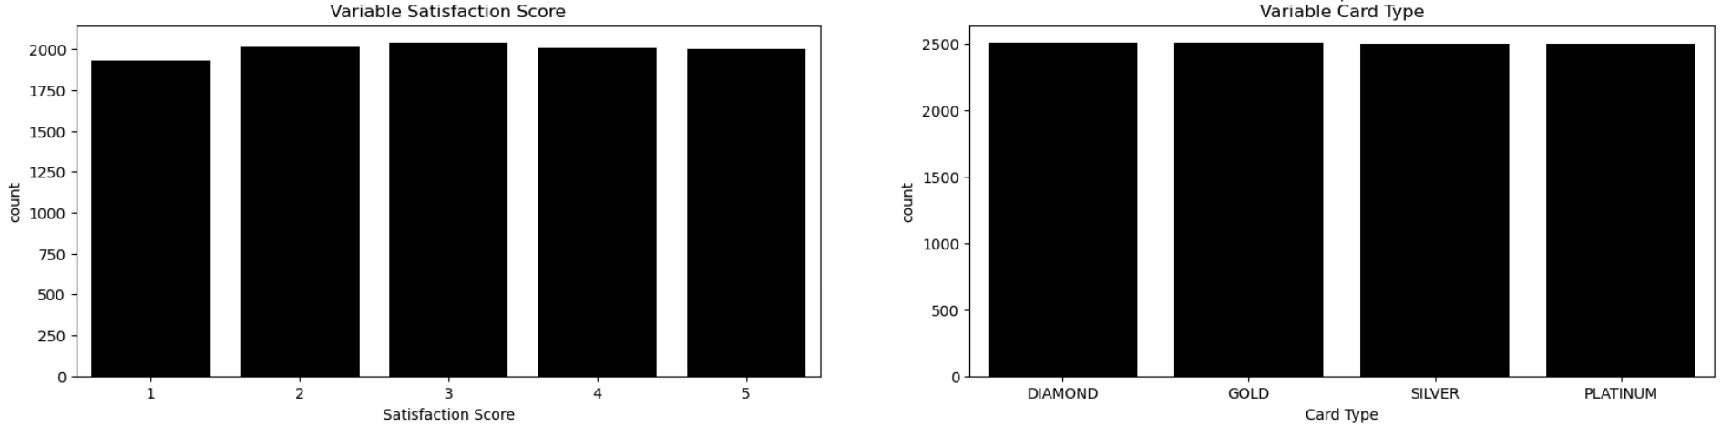
Univariate Analysis
Notes:
Satisfaction Score: Homogenic distribution around 1-5 scores. This is not good, many customers are not satisfied (1-3 represents 60% of customers).
Card Type: Homogenic distribution across plans.

Slide 20
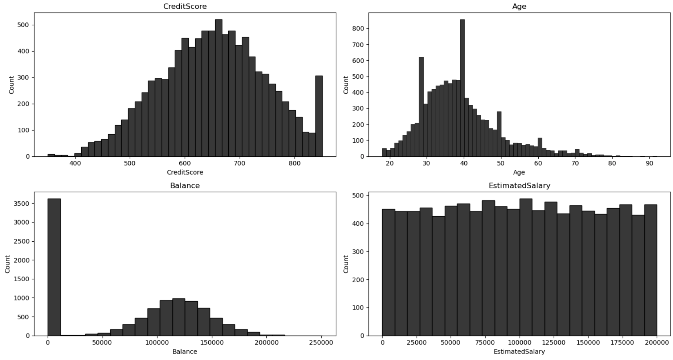
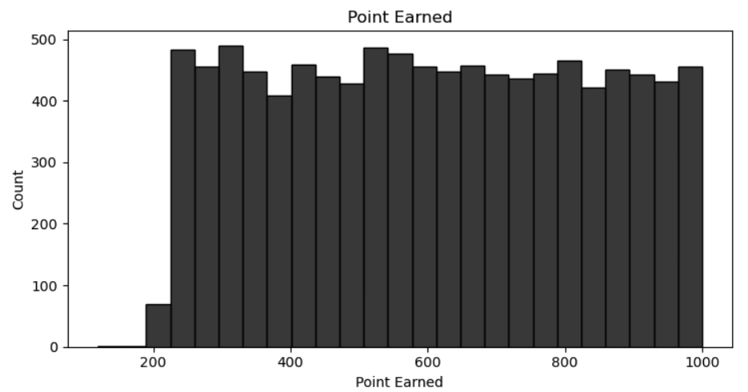
Univariate Analysis
Notes:
Credit Score: Normal distribution, with a light skew in the right. Most customers between 600 & 700 Credit Score.
Age: Bimodal pattern (2 peaks around ages 28 and 40). Most customers between 28-50 years.
Balance: Normal distribution, except of the peak on 0 (inactive accounts).
Estimated Salary: Uniform distribution, no signiffican peaks of valleys.
Point Earned: Uniform distribution, no signiffican peaks of valleys.

Slide 21
Univariate Analysis
Notes:
Credit Score: Normal distribution, with a light skew in the right. Most customers between 600 & 700 Credit Score.
Age: Bimodal pattern (2 peaks around ages 28 and 40). Most customers between 28-50 years.
Balance: Normal distribution, except of the peak on 0 (inactive accounts).
Estimated Salary: Uniform distribution, no signiffican peaks of valleys.
Point Earned: Uniform distribution, no signiffican peaks of valleys.

Slide 22
Univariate Analysis
Notes:
Credit Score: Normal distribution, with a light skew in the right. Most customers between 600 & 700 Credit Score.
Age: Bimodal pattern (2 peaks around ages 28 and 40). Most customers between 28-50 years.
Balance: Normal distribution, except of the peak on 0 (inactive accounts).
Estimated Salary: Uniform distribution, no signiffican peaks of valleys.
Point Earned: Uniform distribution, no signiffican peaks of valleys.

Slide 23
Univariate Analysis
Notes:
Credit Score: Normal distribution, with a light skew in the right. Most customers between 600 & 700 Credit Score.
Age: Bimodal pattern (2 peaks around ages 28 and 40). Most customers between 28-50 years.
Balance: Normal distribution, except of the peak on 0 (inactive accounts).
Estimated Salary: Uniform distribution, no signiffican peaks of valleys.
Point Earned: Uniform distribution, no signiffican peaks of valleys.

Slide 24
Univariate Analysis
Notes:
Credit Score: Normal distribution, with a light skew in the right. Most customers between 600 & 700 Credit Score.
Age: Bimodal pattern (2 peaks around ages 28 and 40). Most customers between 28-50 years.
Balance: Normal distribution, except of the peak on 0 (inactive accounts).
Estimated Salary: Uniform distribution, no signiffican peaks of valleys.
Point Earned: Uniform distribution, no signiffican peaks of valleys.

Slide 25
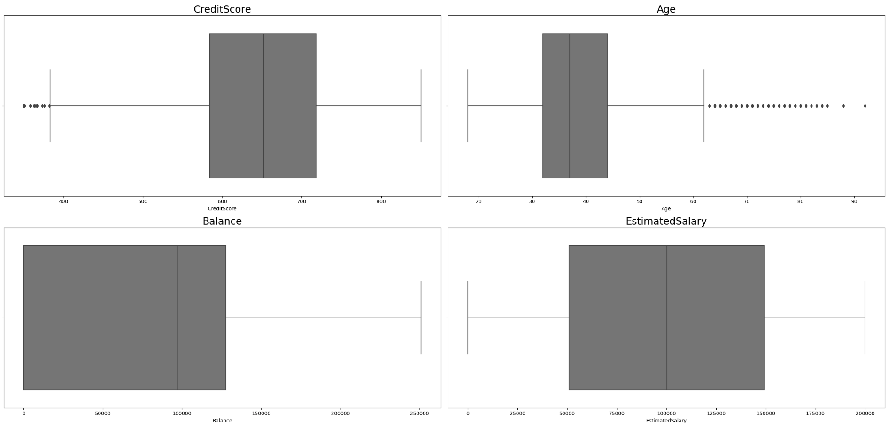
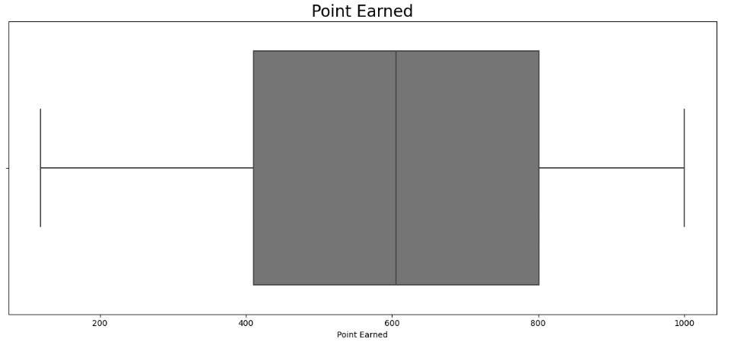
Univariate Analysis
Notes:
I dont find any outliers that can put in risk the quality of the data

Slide 26
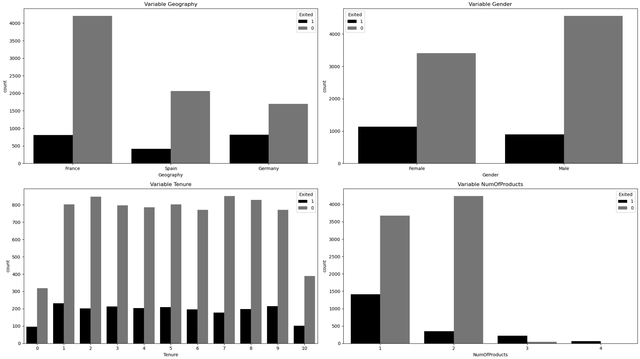
Bivariate analysis vs ‘Exited’
Notes:
All regular distributions

Slide 27
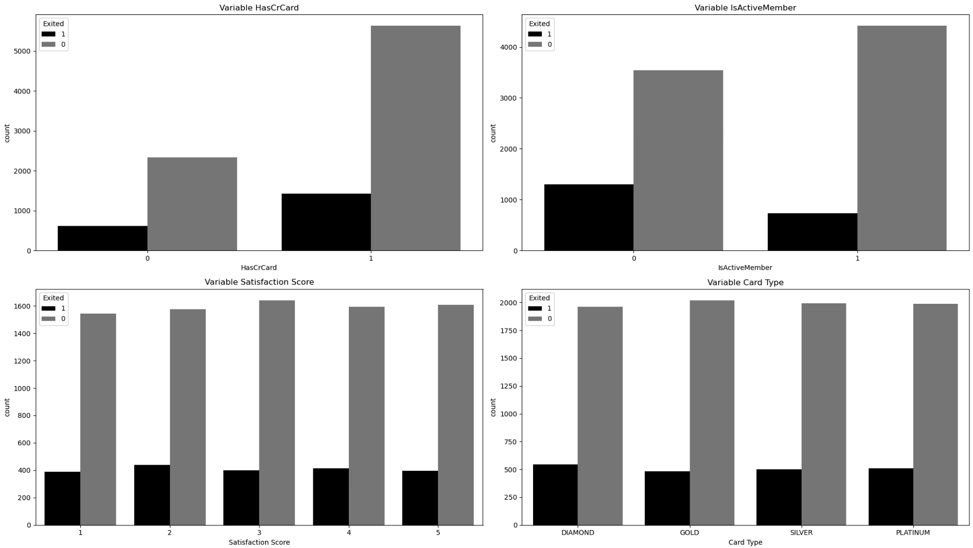
Bivariate analysis vs ‘Exited’
Notes:
All regular distributions

Slide 28
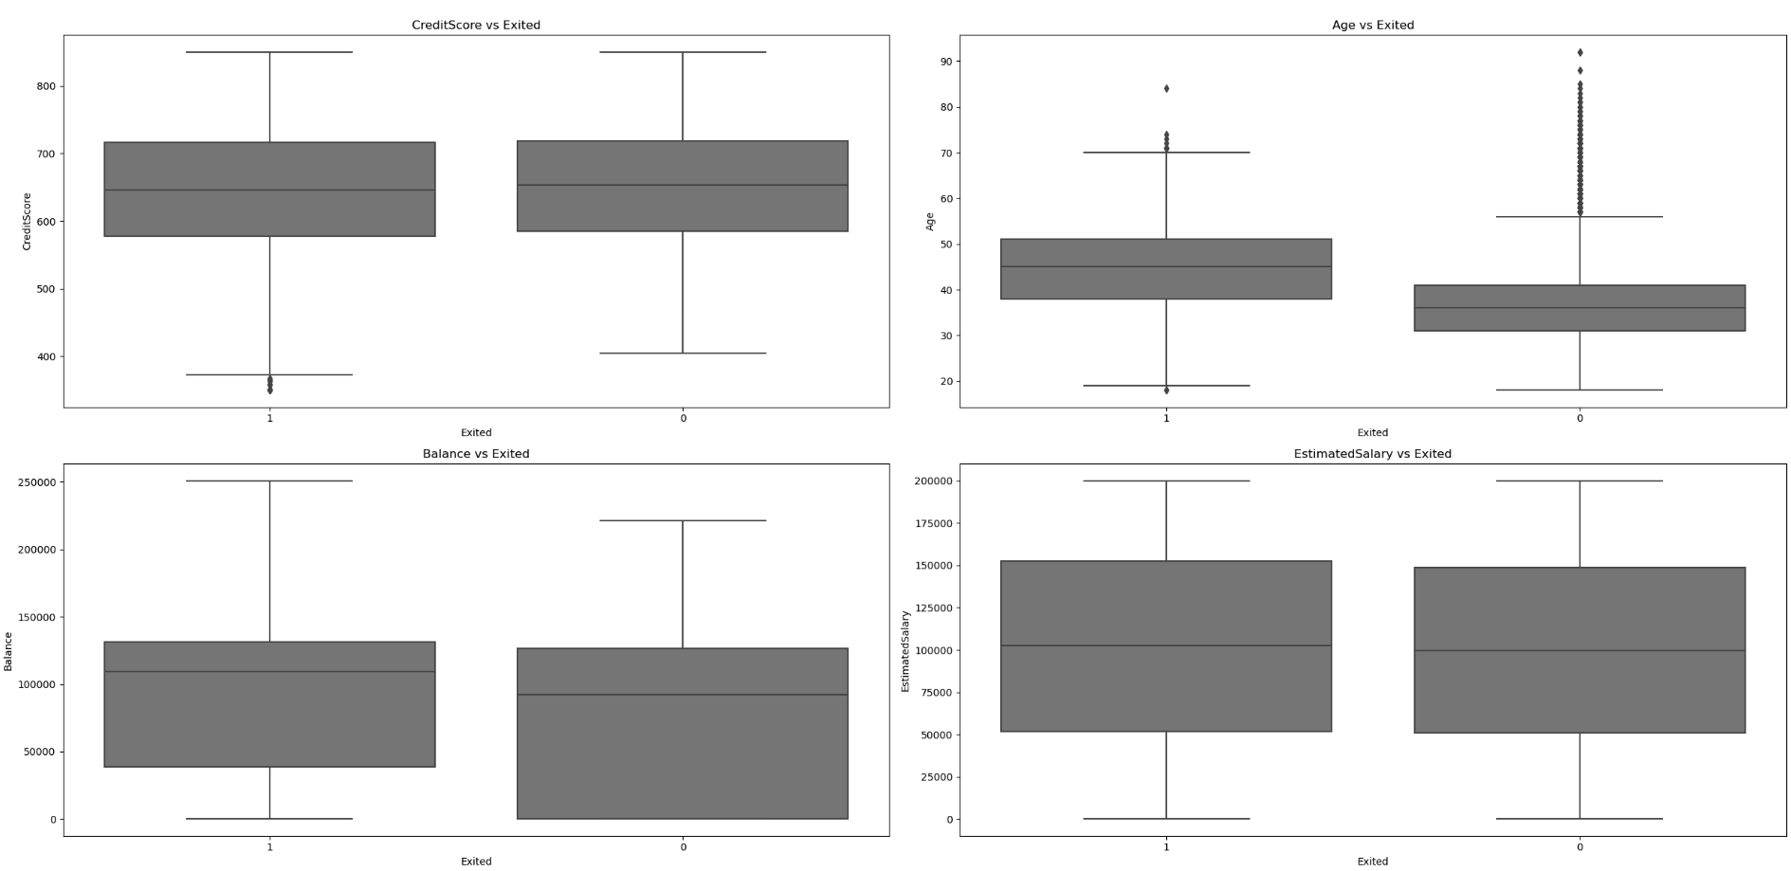
Bivariate analysis vs ‘Exited’
Notes:
All looks normal, except the Age variable. Older customers are more likely to exit (median also higher)

Slide 29
Bivariate analysis vs ‘Exited’
Notes:
All looks normal, except the Age variable. Older customers are more likely to exit (median also higher)

Slide 30
Machine learning

Slide 31
Preparation of dataset
RowNumber
CustomerId
Surname
Complain

Slide 32
Preparation of dataset
RowNumber
CustomerId
Surname
Complain

Slide 33
Train & Test

Slide 34
Train & Test
TRAIN
TEST

Slide 35
Train & Test
NUMERICAL
CATEGORICAL
TRAIN
NUMERICAL
CATEGORICAL
TEST

Slide 36
Train & Test
NUMERICAL
CATEGORICAL
70%
TRAIN
NUMERICAL
CATEGORICAL
30%
TEST

Slide 37

Train & Test
ENCODER
NUMERICAL
CATEGORICAL
70%
TRAIN
NUMERICAL
CATEGORICAL
30%
TEST

Slide 38

Train & Test
ENCODER
NUMERICAL
CATEGORICAL
70%
TRAIN
NUMERICAL
CATEGORICAL
30%
TEST

Slide 39

Train & Test
ENCODER
SCALER
NUMERICAL
CATEGORICAL
70%
TRAIN
NUMERICAL
CATEGORICAL
30%
TEST

Slide 40

Train & Test
ENCODER
SCALER
NUMERICAL
CATEGORICAL
70%
TRAIN
NUMERICAL
CATEGORICAL
30%
TEST

Slide 41
Train & Test
ENCODER
SCALER
NUMERICAL
CATEGORICAL
70%
TRAIN
NUMERICAL
CATEGORICAL
30%
TEST

Slide 42

Train & Test
OVER
SAMPLING
ENCODER
SCALER
NUMERICAL
CATEGORICAL
70%
TRAIN
NUMERICAL
CATEGORICAL
30%
TEST

Slide 43

Train & Test
OVER
SAMPLING
ENCODER
SCALER
NUMERICAL
CATEGORICAL
70%
TRAIN
NUMERICAL
CATEGORICAL
30%
TEST

Slide 44
Ml models

Slide 45
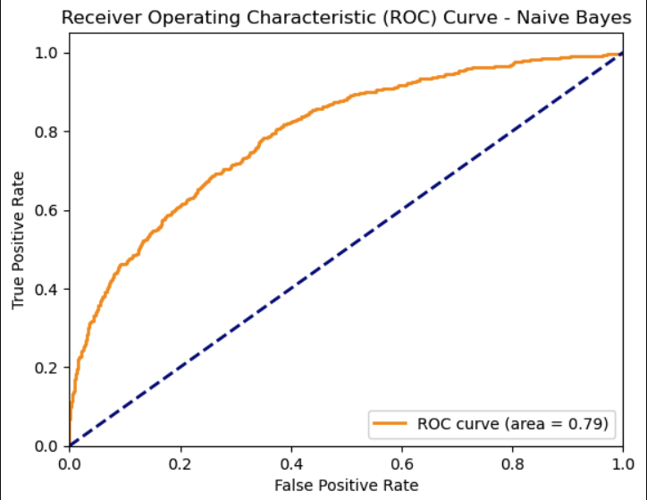
Naive-Bayes
Accuracy: 0.709
Area ROC: 0.79

Slide 46
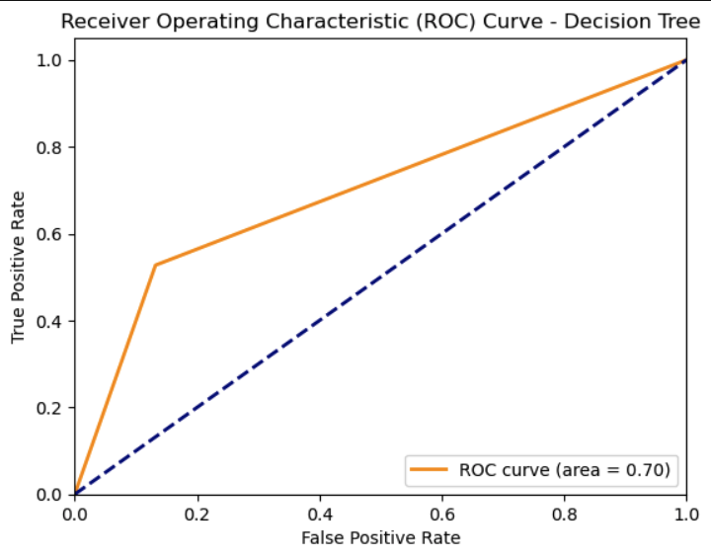
Decision Tree
Accuracy: 0.797
Area ROC: 0.70

Slide 47
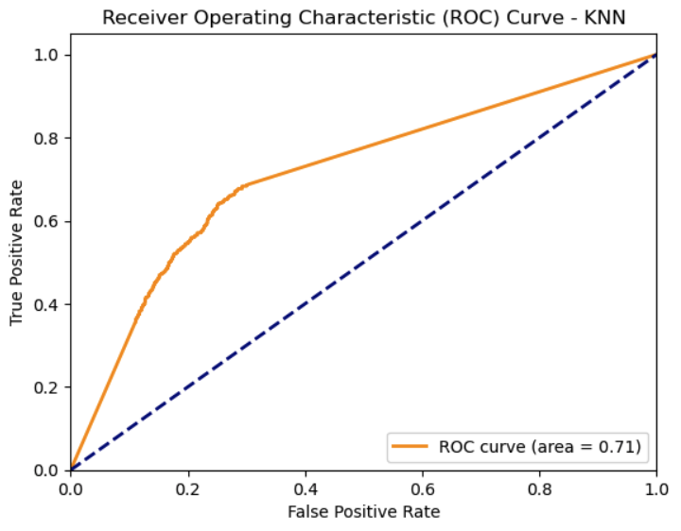
KNN
Accuracy: 0.741
Area ROC: 0.71

Slide 48
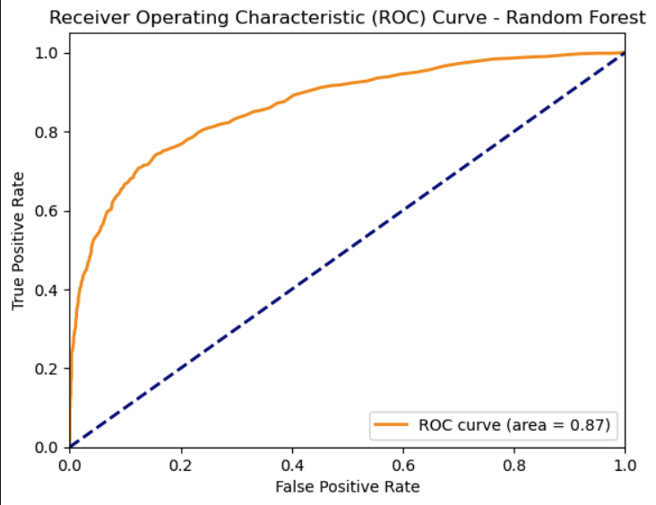
Random Forest (+grid search)
Accuracy: 0.866
Area ROC: 0.87

Slide 49
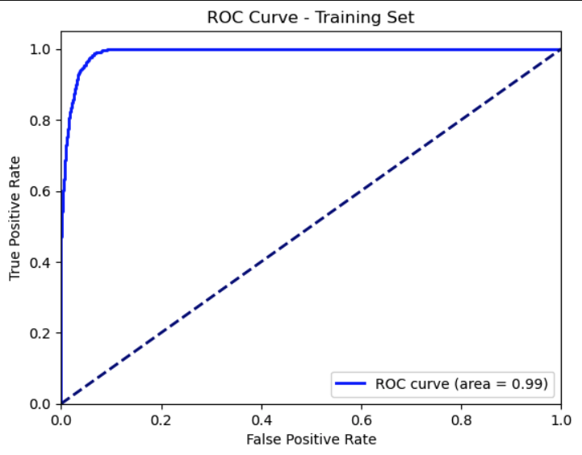
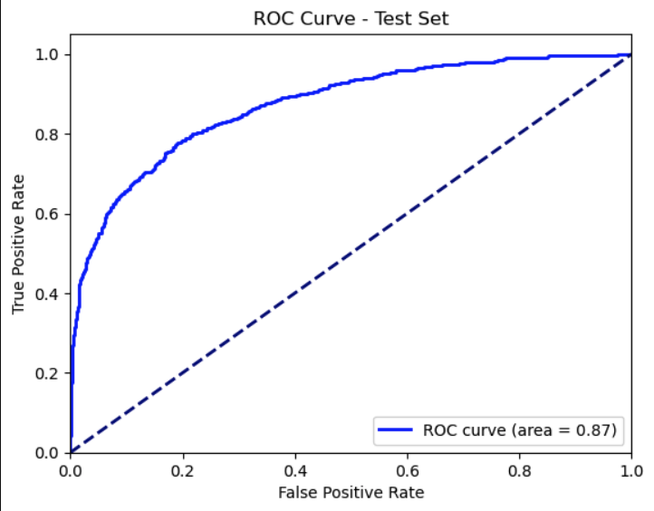
Random Forest (+grid search)
Accuracy: 0.92
Area ROC: 0.99
Accuracy: 0.87
Area ROC: 0.87

Slide 50
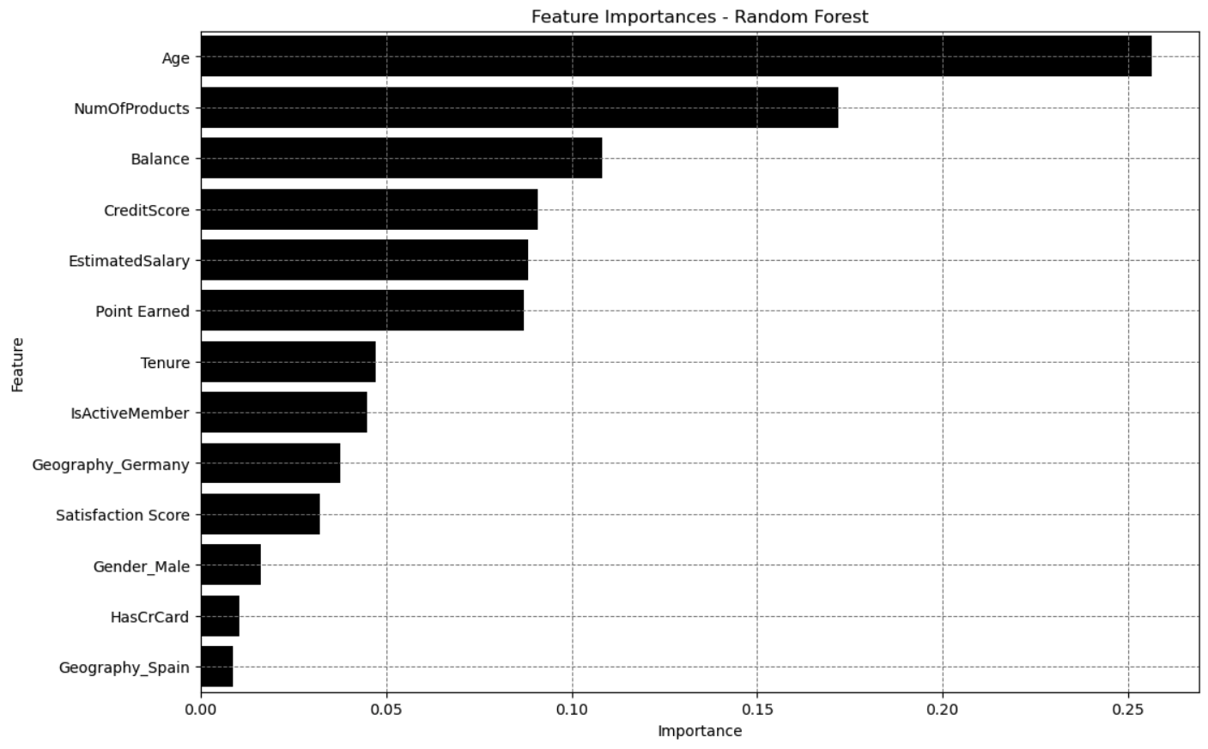
Random Forest (+grid search)

Slide 51
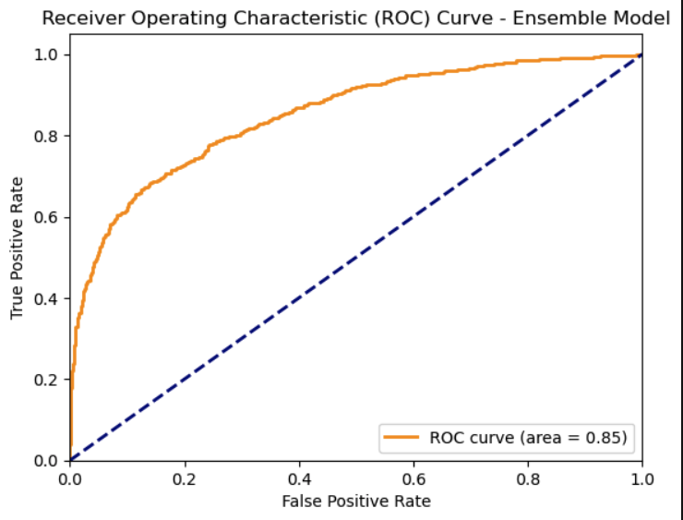
Ensemble (RF + NB)
Accuracy: 0.843
Area ROC: 0.85

Slide 52
Thank you for your attention

